Slide 1

Image Enhancement
Dr. Ratnakar Dash
CSE Dept. of NIT Rourkela

Slide 2
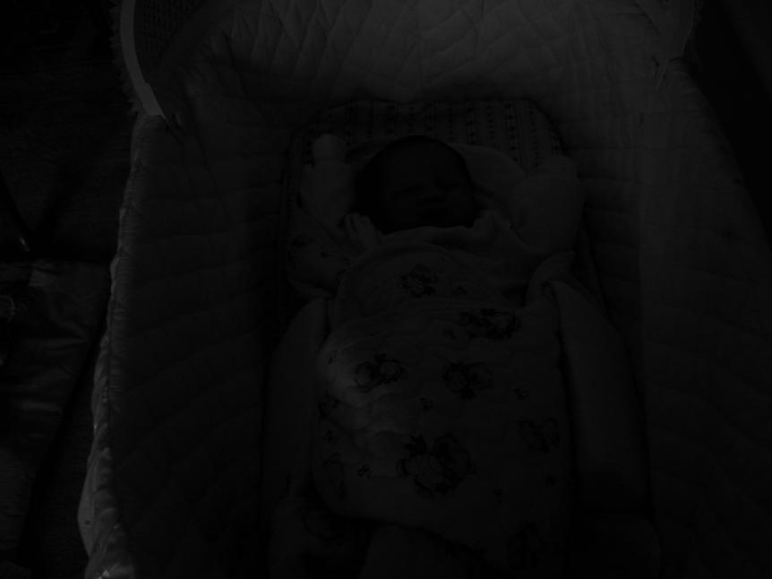
Sometimes Image is not perfect!!

Slide 3
What is Image Enhancement
Processing an image to enhance certain features of the image
Result become more suitable than the original image for specific application
Processing techniques are highly application dependent
e.g Best technique for the enhancement of X-ray images may not be the best one for microscopic images

Slide 4
Different Enhancement Techniques
Spatial Domain Techniques
Work on image plane itself
Direct manipulation of the image pixels
Frequency Domain Techniques
Modify the Fourier Transform coefficients of an image
Take inverse Fourier Transform of the modified coefficients to obtain the enhanced image
Image Enhancement Techniques
Spatial Domain
Frequency Domain

Slide 5
What is a good image?
For Human Visual
The visual evaluation of image quality is a highly subjective process
It is hard to standardize the definition of a good image
For Machine Perception
The evaluation task is easier
The good image is one which gives the best machine recognition result
Before choosing a particular image enhancement method for certain applications, some amount of trial & error is required

Slide 6
Spatial Domain Enhancement Techniques
These techniques are being operated directly on image pixels
Mathematically,
Where, g (x, y) = Enhanced image
f (x, y) = Original image
T = Transformation function defined over the neighbourhood of a pixel
Again can be broadly categorized into following types
Point Processing Techniques
Histogram Based Techniques
Mask Processing Techniques

Slide 7
Neighbourhood
3 × 3 Neighbourhood of a pixel (X, Y)
Y
(X, Y)
X

Slide 8
Point Processing Techniques
Neighborhood = 1x1 pixel
Point operations are zero-memory operations
g depends on only the value of f at (x, y)
T = gray level (or intensity or mapping) transformation function
s = T(r)
Where
r = gray level of f(x, y)
s = gray level of g(x, y)

Slide 9
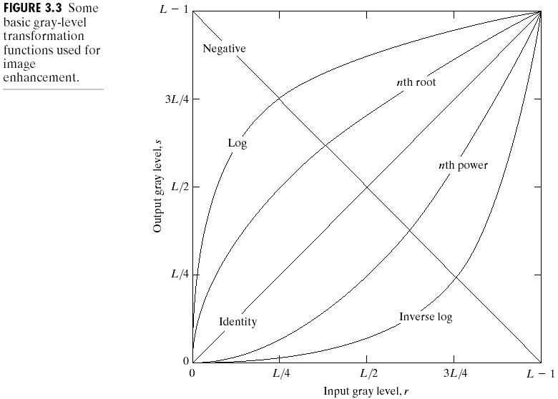
Point Processing Techniques( cont…)
3-basic Gray level Transformation Functions
Linear Functions
Identity transformation
Negative transformation
Logarithm function
Log transformation
Inverse-log transformation
Power-law function
n^{th} power transformation
n^{th} root transformation

Slide 10
Point Processing Techniques( cont…)
Identity Function (or Lazy man operation)
An original image with gray level in the range [0, L-1]
Identity transformation :
s =T (r) = r
Absolutely no effect on the
visual quality of the image.
s
L-1
r
0
L-1

Slide 11
Point Processing Techniques( cont…)
Image Negative
An original image with gray level in the range [0, L-1]
Negative transformation :
s =T (r) = L – 1 –r
Reversing the intensity levels of an image.
Suitable for enhancing white or gray detail
embedded in dark regions of an image,
especially when the black area dominant
in size
s
L-1
r
0
L-1

Slide 12
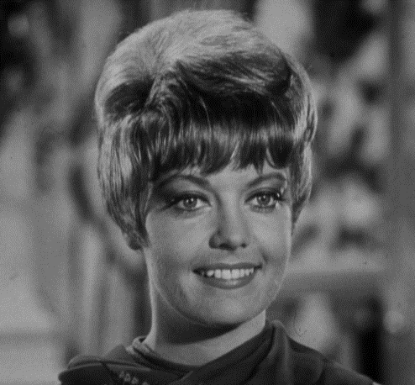
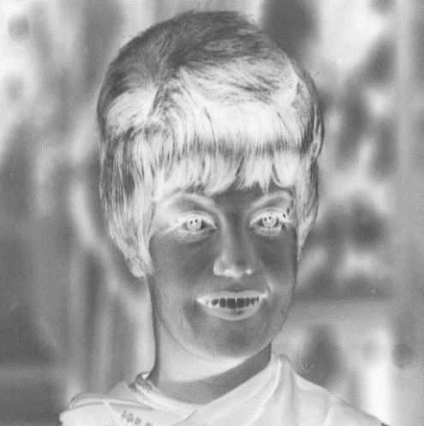
Point Processing Techniques( cont…)
Example of Image Negative

Slide 13
Point Processing Techniques( cont…)
Log Transformation
An original image with gray level in the range [0, L-1]
Log transformation :
s = c log (1+r)
Where c = const. and r ≥ 0
Log curve maps a narrow range of
low gray-level values in the input image
into a wider range of output levels .
Suitable for enhancing white or gray detail
embedded in dark regions of an image,
especially when the black area dominant
in size
s
L-1
r
0
L-1

Slide 14
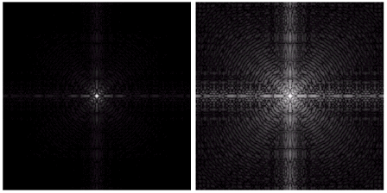
Point Processing Techniques( cont…)
Example of Log Transformation
Fourier Spectrum with range = 0 to 1.5 x 10⁶
Result after apply the log transformation with c = 1, range = 0 to 6.2

Slide 15
Point Processing Techniques( cont…)
Inverse-Log Transformation
An original image with gray level in the range [0, L-1]
Opposite of the log transform
Used to expand the values of high pixels
in an image while compressing the
darker-level values.
Inverse-Log curve maps a wider range of
low gray-level values in the input image
into a narrow range of output levels .
s
L-1
r
0
L-1

Slide 16
Point Processing Techniques( cont…)
Power-law (GAMMA) transformation
An original image with gray level in the range [0, L-1]
Has the basic mathematical form
s = c . r^{γ}
Power-law curves with fractional values of γ map a narrow range of
dark input values into a wider range of output values, with the
opposite being true for higher values of input levels.
c = γ = 1  Identity function

Slide 17
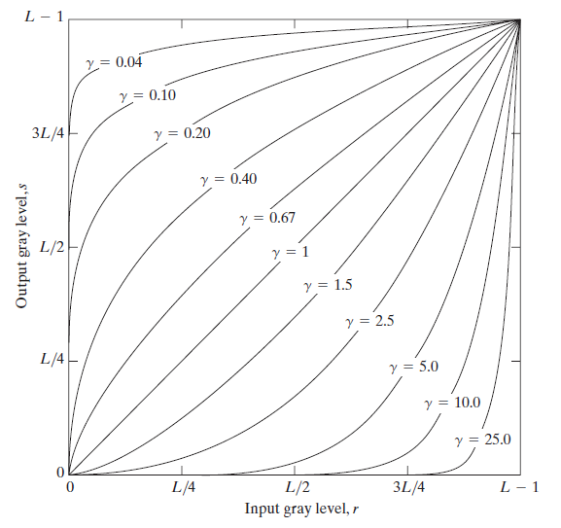
Point Processing Techniques( cont…)
Power-law (GAMMA) transformation
Input gray level, r
Plots of s = cr^{γ} for various values of γ (c = 1 in all cases)

Slide 18
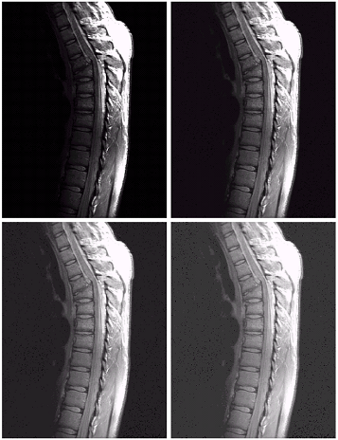
Point Processing Techniques( cont…)
Examples Power-law (GAMMA) transformation
a | b
c | d
(a) A magnetic resonance image of an upper thoracic human spine with a fracture dislocation and spinal cord impingement
The picture is predominately dark
An expansion of gray levels are desirable  needs γ < 1
(b) Result after power-law transformation with γ = 0.6, c=1
(c) Transformation with γ = 0.4
(best result)
(d) transformation with γ = 0.3
(under acceptable level)

Slide 19
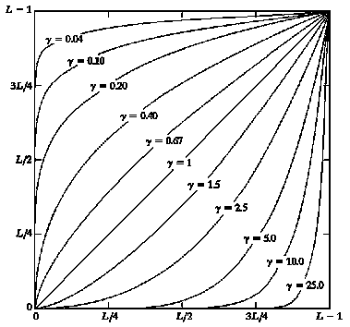
Point Processing Techniques( cont…)
Effect of Decreasing Gamma
When the γ is reduced too much, the image begins to reduce contrast to the point where the image started to have very slight “wash-out” look, especially in the background
Input gray level, r
Plots of s = cr^{γ} for various values of γ (c = 1 in all cases)

Slide 20
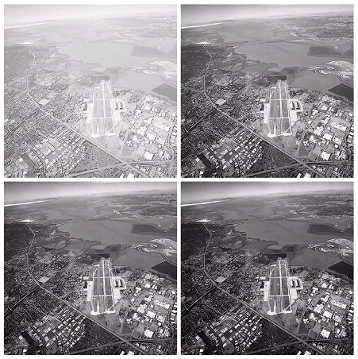
Point Processing Techniques( cont…)
Another Examples Power-law transformation
a | b
c | d
image has a washed-out appearance, it needs a compression of gray levels  needs γ > 1
(b) result after power-law
transformation with γ = 3.0 (suitable)
(c) transformation with γ = 4.0
(suitable)
(d) transformation with γ = 5.0
(high contrast, the image has areas that are too dark, some detail is lost)

Slide 21
Point Processing Techniques( cont…)
Piecewise-Linear Transformation Functions
Contrast Stretching
Thresholding
Gray Level Slicing
Bit Plane Slicing

Slide 22
Point Processing Techniques( cont…)
Contrast Stretching
Increases the dynamic range
of gray levels in the image
Thresholding is a special case of contrast stretching
s
s_{b}
s_{a}
a
b
r
0
L

Slide 23
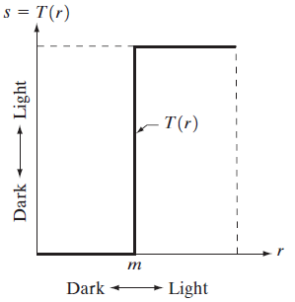
Point Processing Techniques( cont…)
Thresholding
Produces a two level (binary ) image
Pixels above threshold grouped into
one class and below threshold to
another class

Slide 24
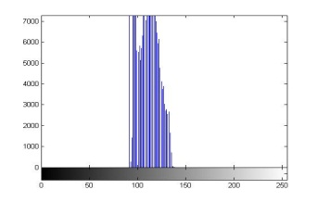
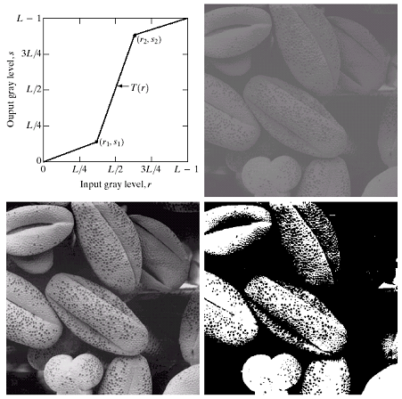
Point Processing Techniques( cont…)
Contrast Stretching & Thresholding Example
a low-contrast image : result from poor illumination, lack of dynamic range in the imaging sensor, or even wrong setting of a lens aperture of image acquisition
result of contrast stretching:
(r₁,s₁) = (r_{min},0) and
(r₂,s₂) = (r_{max},L-1)
result of thresholding

Slide 25
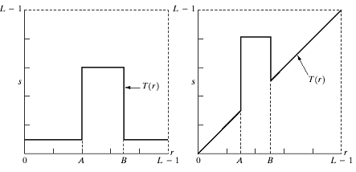
Point Processing Techniques( cont…)
Gray-level slicing
Highlighting a specific range of gray levels in an image
Display a high value of all gray levels in the range of interest and a low value for all other gray levels

Slide 26
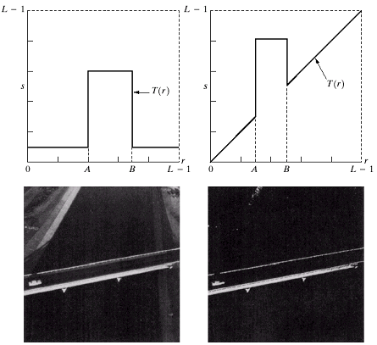
Point Processing Techniques( cont…)
Gray-level slicing Example
(a) transformation highlights range [A,B] of gray level and reduces all others to a constant level
(b) transformation highlights range [A,B] but preserves all other levels
(c) Original image
(d) Result of applying the transformation (a) on the image at (c)
a | b
c | d

Slide 27
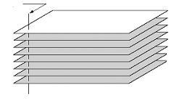
Point Processing Techniques( cont…)
Bit-plane Slicing
Highlights the contribution made
to total image appearance by
specific bits
Suppose each pixel is represented by 8 bits
Higher-order bits contain the majority
of the visually significant data.
Useful for analyzing the relative importance
played by each bit of the image
One 8-bit byte
Bit-plane 7
(most significant)
Bit-plane 0
(least significant)

Slide 28
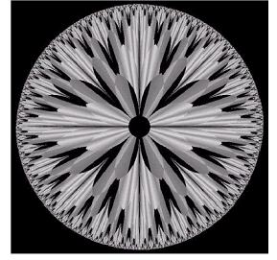
Point Processing Techniques( cont…)
Bit-plane Slicing Example
The (binary) image for bit-plane 7 can be obtained by processing the input image with a thresholding gray-level transformation.
Map all levels between 0 and 127 to 0
Map all levels between 128 and 255 to 255
An 8-bit fractal image

Slide 29
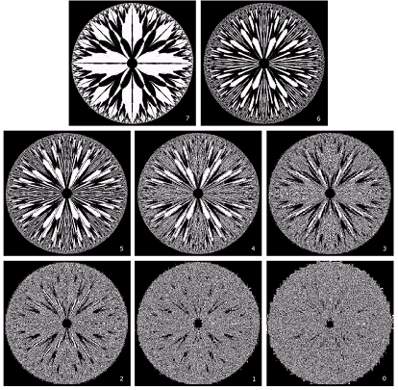
Point Processing Techniques( cont.…)
Bit-plane Slicing Example (cont.…)
Bit-plane 7 |  | Bit-plane 6
Bit-plane 5 | Bit-plane 4 |  | Bit-plane 3
Bit-plane 2 | Bit-plane 1 |  | Bit-plane 0
[ 8- Bit planes ]

Slide 30
Summary of Point Processing Techniques
So far, we have discussed various forms of mapping function T(r) that leads to different enhancement results.
The natural question is: How to select an appropriate T(r) for an arbitrary image?
One systematic solution is based on the histogram information of an image

Slide 31
Histogram Processing Techniques
Histogram of an image represents the relative frequency of occurrence of various gray levels in the image
Takes care the global appearance of an image
Basic method for numerous spatial domain processing techniques
Used effectively for image enhancement

Slide 32
Why Histogram Processing Techniques?
It is a baby in the cradle!
Histogram information reveals that image is under-exposed

Slide 33
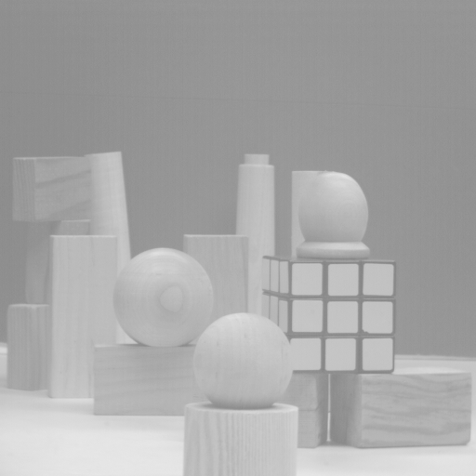
Why Histogram Processing Techniques?
Over-exposed image
Histogram information reveals that image is over-exposed

Slide 34
Histogram Processing Techniques (cont.…)
Histogram of an Image
Histogram of a digital image with gray levels in the range
[0 L-1], is a discrete function
h(r_{k}) = n_{k}
Where
r_{k} : the k^{th} gray level
n_{k} : the number of pixels in the image having gray level r_{k}
h(r_{k}) : histogram of a digital image with gray levels r_{k}

Slide 35
Histogram Processing Techniques (cont.…)
A Basic Histogram Example
No. of pixels
6
2 | 3 | 3 | 2
4 | 2 | 4 | 3
3 | 2 | 3 | 5
2 | 4 | 2 | 4
5
4
3
2
Gray level
1
4x4 image
Gray scale = [0,9]
0
1
2
3
4
5
6
7
8
9
histogram

Slide 36
Histogram Processing Techniques (cont.…)
Normalized Histogram
dividing each of histogram at gray level rk by the total number of pixels in the image, n
p(r_{k}) =n_{k}/n
For k = 0,1,…,L-1
p(r_{k}) gives an estimate of the probability of occurrence of gray level r_{k}
The sum of all components of a normalized histogram is equal to 1

Slide 37
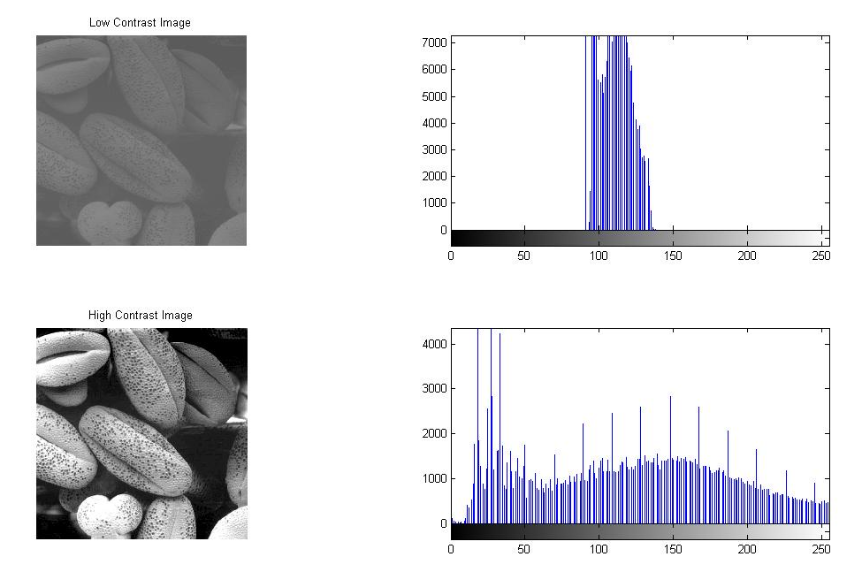
Histogram Processing Techniques (cont.…)
Histograms of different types of images
Low-contrast image
histogram is narrow and centered toward the middle of the gray scale
High-contrast image
histogram covers broad range of the gray scale and the distribution of pixels is not too far from uniform, with very few vertical lines being much higher than the others

Slide 38
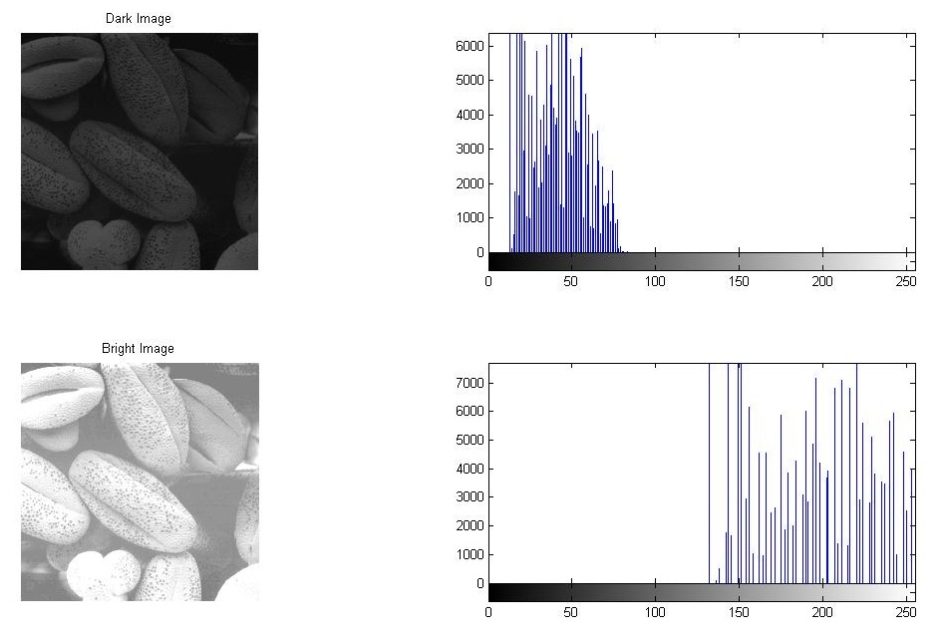
Histogram Processing Techniques (cont.…)
Histograms of different types of images
Dark image
Components of histogram are concentrated on the low side of the gray scale.
Bright image
Components of histogram are concentrated on the high side of the gray scale.

Slide 39
Histogram Processing Techniques (cont.…)
Histogram Processing Techniques
Histogram Equalization
Histogram Specification
Histogram Specification can also be called histogram modification or histogram matching

Slide 40
Histogram Processing Techniques (cont.…)
Histogram Equalization
Basic Idea: find a map f(x) such that the histogram of the modified (equalized) image is flat (uniform).
Key Motivation: probability density function (pdf) of a random variable approximates a uniform distribution.
Suppose h(t) is the histogram (pdf),

Slide 41
Histogram Processing Techniques (cont.…)
Histogram Equalization (cont.…)
As the low-contrast image’s histogram is narrow and centred toward the middle of the gray scale, if we distribute the histogram to a wider range the quality of the image will be improved.
We can do it by adjusting the probability density function of the original histogram of the image so that the probability spread equally

Slide 42
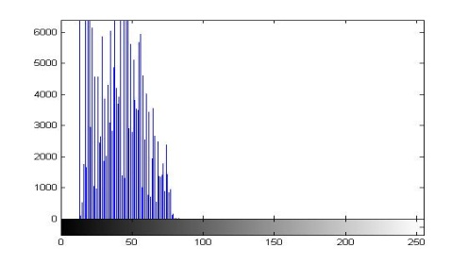
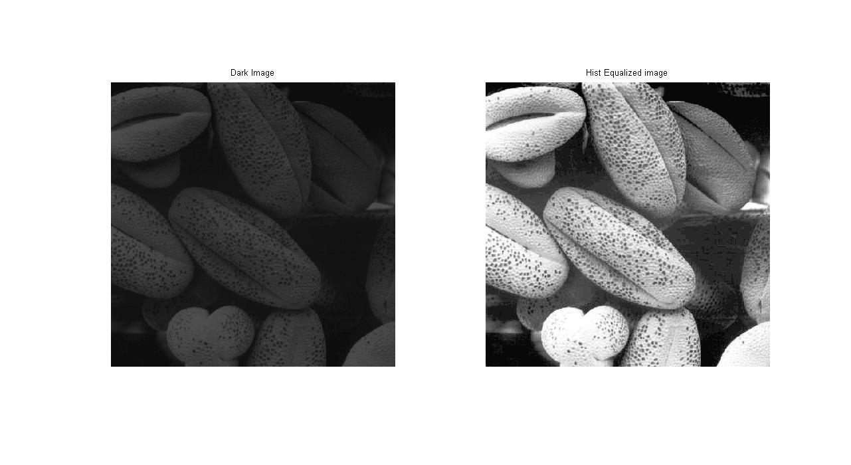
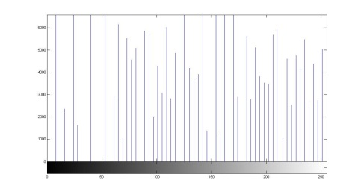
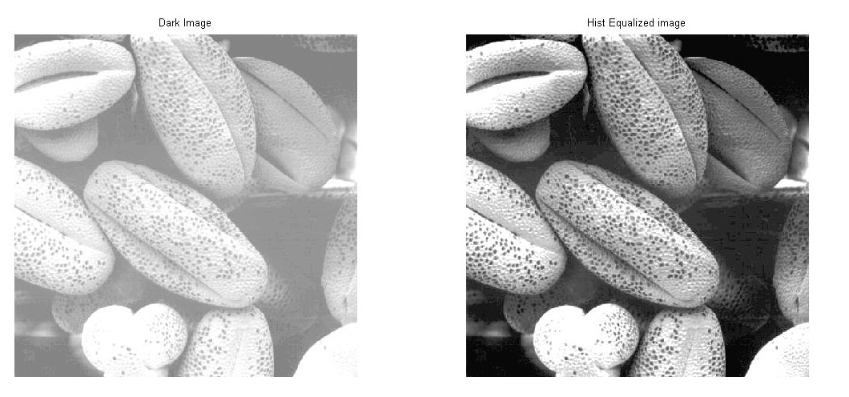
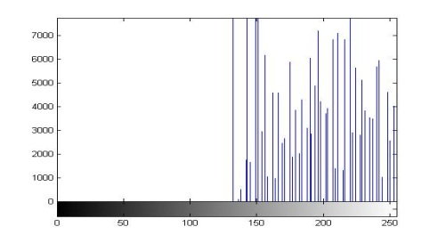
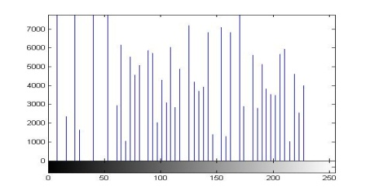
Histogram Processing Techniques (cont.…)
Histogram Equalization Example
Before
After Equalization

Slide 43
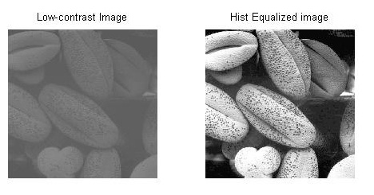

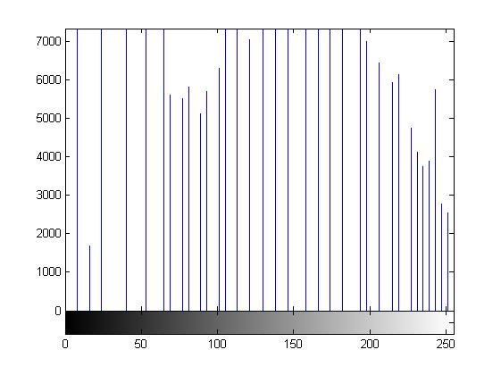
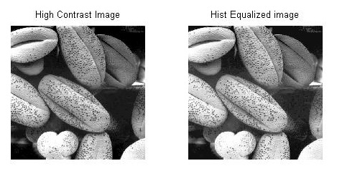
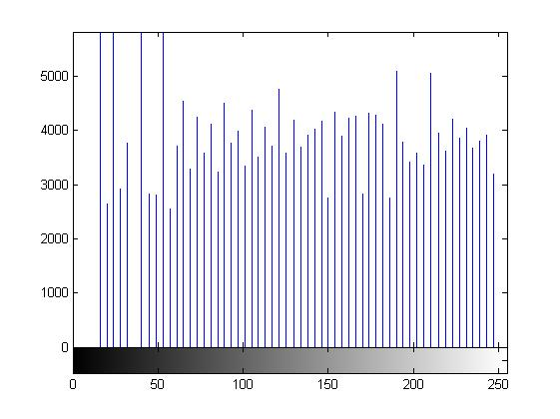
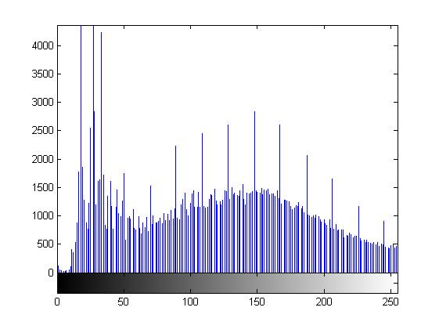
Histogram Processing Techniques (cont.…)
Histogram Equalization Example (cont.….)
After Equalization
Before

Slide 44
Histogram Processing Techniques (cont.…)
Histogram Equalization Example (cont.….)
After Equalization
Before
The quality is not improved much because the original image already has a broaden gray-level scale

Slide 45
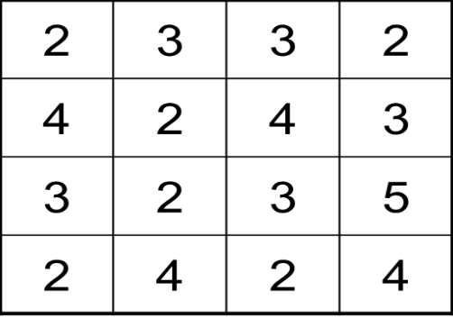
Histogram Processing Techniques (cont.…)
A Sample Example of Histogram Equalization (cont.…)
No. of pixels
6
5
4
3
2
4x4 image
1
Gray scale = [0,9]
0
1
2
3
4
5
6
7
8
9
Gray level
histogram

Slide 46
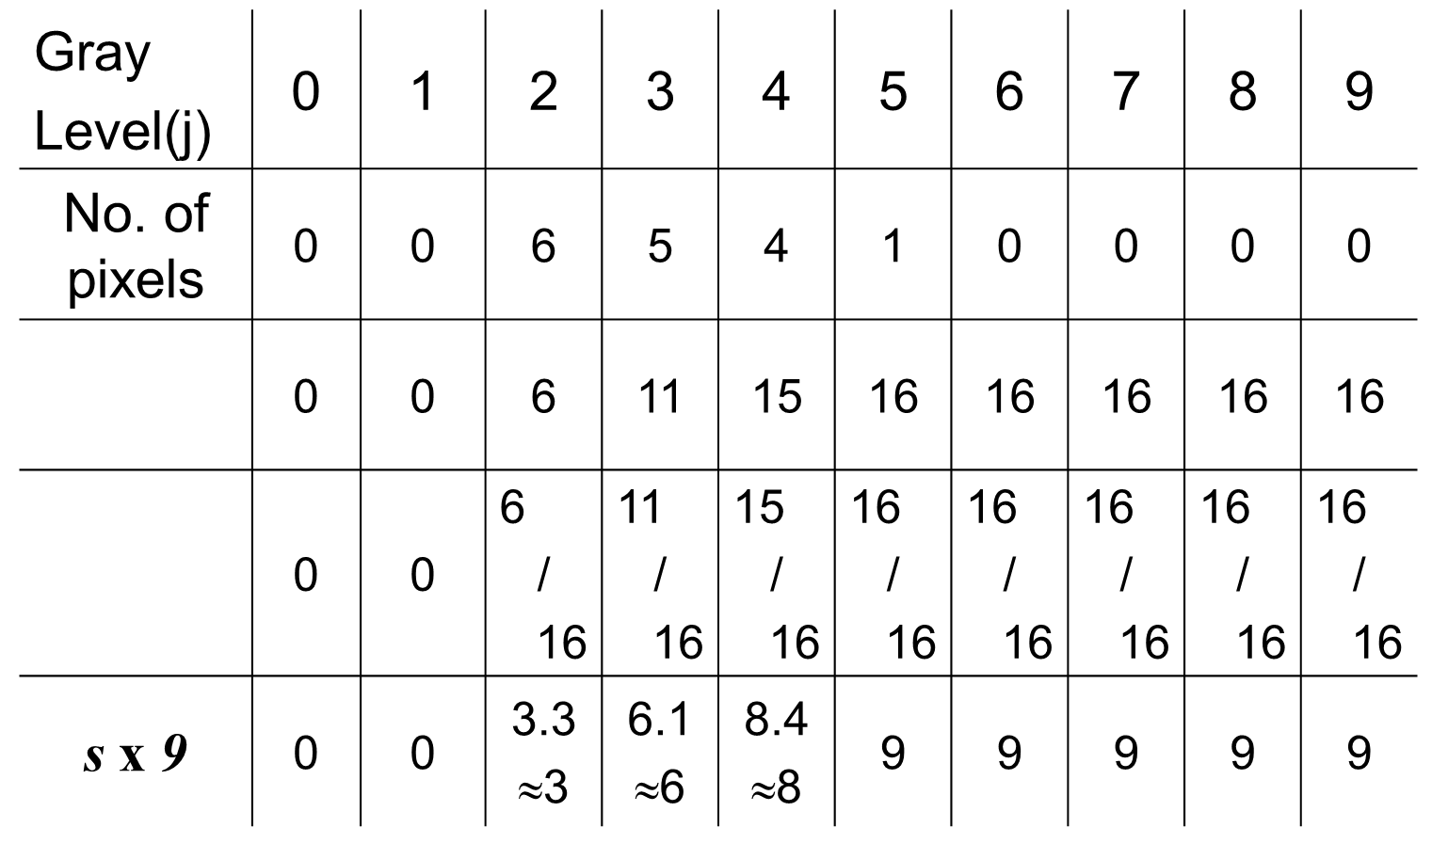
Histogram Processing Techniques (cont.…)
A Sample Example of Histogram Equalization (cont.…)

Slide 47
Histogram Processing Techniques (cont.…)
A Sample Example of Histogram Equalization (cont.…)
No. of pixels
3 | 6 | 6 | 3
8 | 3 | 8 | 6
6 | 3 | 6 | 9
3 | 8 | 3 | 8
6
5
4
3
2
1
Output image
Gray scale = [0,9]
0
1
2
3
4
5
6
7
8
9
Gray level
Histogram equalization

Slide 48
Histogram Processing Techniques (cont.…)
Histogram Specification
Basic Idea: To generate an image which has a specified histogram that we wish the processed image to have
Key Motivation: The disadvantage of histogram equalization, i.e. it can generate only one type of out put image

Slide 49
Histogram Processing Techniques (cont.…)
Histogram Specification (Block Diagram)
r
Histogram Equalization
s = T (r)
Histogram Equalization
g = G(z)
z
s = g

Slide 50
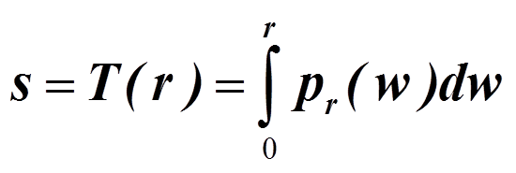
Histogram Processing Techniques (cont.…)
Histogram Specification (Continuous Domain)
Let p_{r}(r) denote continuous probability density function of gray-level of input image, r
Let p_{z}(z) denote desired (specified) continuous probability density function of gray-level of output image, z
Let s be a random variable with the property
Histogram equalization
Where w is a dummy variable of integration

Slide 51
Histogram Processing Techniques (cont.…)
Histogram Specification (Continuous Domain) [cont..]
Next, we define a random variable z with the property
Histogram equalization
Where t is a dummy variable of integration
s = T(r) = G(z)
Therefore, z must satisfy the condition
z = G⁻¹(s) = G⁻¹[T(r)]
Assume G⁻¹ exists. Now, we can map an input gray level r to output gray level z

Slide 52
Histogram Processing Techniques (cont.…)
Summary of Histogram Specification Procedure
Step :1 Obtain the transformation function T(r) by calculating the histogram equalization of the input image
Step :2 Obtain the transformation function G(z) by calculating histogram equalization of the desired density function
Step :3 Obtain the inversed transformation function G⁻¹
Step :4 Obtain the output image by applying the processed gray-level from the inversed transformation function to all the pixels in the input image
z = G⁻¹(s) = G⁻¹ [T(r)]

Slide 53
Histogram Processing Techniques (cont.…)
An Example of Histogram Specification
Assume an image has a gray level probability density function p_{r}(r) as shown.
p_{r}(r)
2
1
0
1
2
r

Slide 54
Histogram Processing Techniques (cont.…)
An Example of Histogram Specification
We would like to apply the histogram specification with the desired probability density function p_{z}(z) as shown.
p_{z}(z)
2
1
0
1
2
z

Slide 55
Histogram Processing Techniques (cont.…)
An Example of Histogram Specification (Solution)
Step 1:
Obtain the transformation function T(r)
s=T(r)
1
One to one mapping function
0
1
r

Slide 56
Histogram Processing Techniques (cont.…)
An Example of Histogram Specification (Solution)
Step 2:
Obtain the transformation function G(z)

Slide 57
Histogram Processing Techniques (cont.…)
An Example of Histogram Specification (Solution)
Step 3:
Obtain the inversed transformation function G⁻¹
We can guarantee that 0 ≤ z ≤1 when 0 ≤ r ≤1

Slide 58
Histogram Processing Techniques (cont.…)
Histogram Specification (Discrete Domain)

Slide 59
Histogram Processing Techniques (cont.…)
An Example Histogram Specification (Discrete Domain)
Intensity range [0 L-1]=[0 7]
Input Histogram |  | Specified Histogram
r_{k} | pr(r_{k}) | z_{q} | pr(z_{q})
0 | 0.19 | 0 | 0.00
1 | 0.25 | 1 | 0.00
2 | 0.21 | 2 | 0.00
3 | 0.16 | 3 | 0.15
4 | 0.08 | 4 | 0.20
5 | 0.06 | 5 | 0.30
6 | 0.03 | 6 | 0.20
7 | 0.02 | 7 | 0.15

Slide 60
Histogram Processing Techniques (cont.…)
An Example Histogram Specification (Discrete Domain)
Input Histogram
r_{k} | pr(r_{k}) | s_{k}=
0 | 0.19 | 1.33≈ 1
1 | 0.25 | 3.08 ≈ 3
2 | 0.21 | 4.55 ≈ 5
3 | 0.16 | 5.67 ≈ 6
4 | 0.08 | 6.23 ≈ 6
5 | 0.06 | 6.65 ≈ 7
6 | 0.03 | 6.86 ≈ 7
7 | 0.02 | 7.00 ≈ 7
Intensity range [0 L-1]=[0 7]
S
T
E
P
1
Mapping Table
r_{k} | s_{k}
0 | 1
1 | 3
2 | 5
3 | 6
4 | 6
5 | 7
6 | 7
7 | 7

Slide 61
Histogram Processing Techniques (cont.…)
An Example Histogram Specification (Discrete Domain)
Specified Histogram
z_{q} | pr(z_{q}) | g_{q}=
0 | 0.00 | 0.00 ≈ 0
1 | 0.00 | 0.00 ≈ 0
2 | 0.00 | 0.00 ≈ 0
3 | 0.15 | 1.05 ≈ 1
4 | 0.20 | 2.45 ≈ 2
5 | 0.30 | 4.55 ≈ 5
6 | 0.20 | 5.95 ≈ 6
7 | 0.15 | 7.00 ≈ 7
Intensity range [0 L-1]=[0 7]
S
T
E
P
2
Mapping Table
z_{q} | g_{q}
0 | 0
1 | 0
2 | 0
3 | 1
4 | 2
5 | 5
6 | 6
7 | 7

Slide 62
Histogram Processing Techniques (cont.…)
An Example Histogram Specification (Discrete Domain)
Intensity range [0 L-1]=[0 7]
S
T
E
P
3
Mapping Table
s_{k} | z_{q}
1 | 3
3 | 4
5 | 5
6 | 6
7 | 7
Map s_{k} to z_{q} based on common g_{q}

Slide 63
Histogram Processing Techniques (cont.…)
An Example Histogram Specification (Discrete Domain)
Intensity range [0 L-1]=[0 7]
Mapping Table
r_{k} | s_{k} | z_{q}
0 | 1 | 3
1 | 3 | 4
2 | 5 | 5
3 | 6 | 6
4 | 6 | 6
5 | 7 | 7
6 | 7 | 7
7 | 7 | 7
S
T
E
P
4
Final Mapping
r_{k} z_{q}

Slide 64
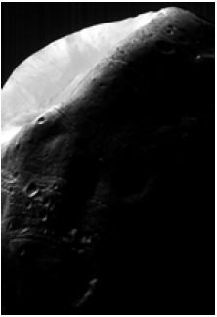
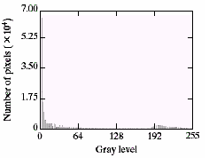
Histogram Processing Techniques (cont.…)
Comparison Between Histogram Equalization and specification using Example
Image is dominated by large, dark areas, resulting in a histogram characterized by a large concentration of pixels in pixels in the dark end of the gray scale
Image of Mars moon

Slide 65
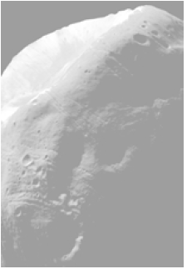
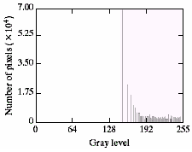
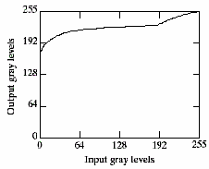
Histogram Processing Techniques (cont.…)
Comparison Between Histogram Equalization and specification using Example
Transformation function for histogram equalization
Histogram of the result equalized image
Resultant equalized image
Look at the washed out appearance of equalized image which is not at all expected

Slide 66
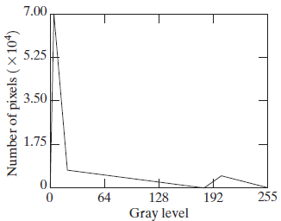
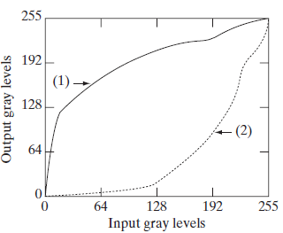
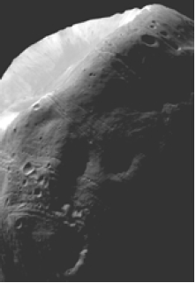
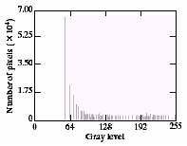
Histogram Processing Techniques (cont.…)
Comparison Between Histogram Equalization and specification using Example
Specified Histogram
Transformations
Resultant Histogram
Resultant Specified image

Slide 67
Histogram Processing Techniques (cont.…)
A Special note on Histogram Specification
Histogram specification is a trial-and-error process
There are no rules for specifying histograms, and one must resort to analysis on a case-by-case basis for any given enhancement task.

Slide 68
Mask Processing Techniques
Neighborhood under consideration is greater than 1×1 pixel.
That means the neighbourhood must be of size 3×3, 5×5 or 7×7 etc.
Instead of acting on a single pixel, the transformation function is acting over the neighbourhood of the pixel under consideration
The transformation function is in the form of a mask.
Mask value shows what kind of enhancement is going to be achieved.

Slide 69
Mask Processing Techniques (cont.…)
3 × 3 Neighbourhood of a pixel (X, Y) and the Mask
(X, Y)
Y
W_{-1,-1} | W_{-1,0} | W_{-1,1}
W_{0,-1} | W_{0,0} | W_{0,1}
W_{1,-1} | W_{0,1} | W_{1,1}
X
3×3 MASK
Mathematically, the enhance image can be written as

Slide 70
Mask Processing Techniques (cont.…)
Mask processing techniques can be of the following types
Linear Smoothing/ Linear Filtering
Median Filtering
Sharpen Filtering

Slide 71
Mask Processing Techniques (cont.…)
Linear Smoothing
Image Averaging Operation
Replaces the intensity value of the pixel under consideration with the average of the intensity values of its neighbourhood.
The mask used here is
O/p Image is a smooth image i.e. sharp edges are blurred.
Blur will be more if mask size is getting bigger and bigger.
₁ | ₁ | ₁
₁ | ₁ | ₁
₁ | ₁ | ₁

Slide 72
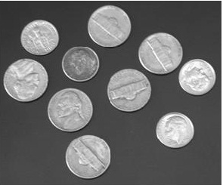
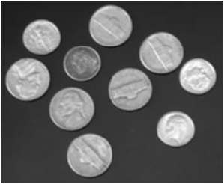

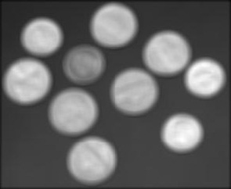
Mask Processing Techniques (cont.…)
Examples of Linear Smoothing
Image Averaging Operation
Original Image
Using 3×3 mask
Using 9×9 mask
Using 5×5 mask

Slide 73
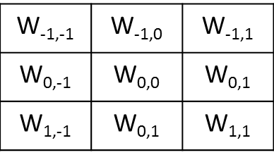
Mask Processing Techniques (cont.…)
Linear Smoothing (cont.…)
Weighted Averaging Operation
Replaces the intensity value of the pixel under consideration with the weighted-average of the intensity values of its neighbourhood.
The mask used here is
Blur will be some how reduced as compared to simple averaging.
₁ | ₂ | ₁
₂ | ₄ | ₂
₁ | ₂ | ₁
[ An Example]

Slide 74

Mask Processing Techniques (cont.…)
Examples of Linear Smoothing
Weighted Averaging Operation
Original Image
Simple Avg
Using 3×3 mask
Weighted Avg
Using 3×3 mask

Slide 75
Mask Processing Techniques (cont.…)
Median Filtering
Based on order statistics and hence is a non-linear filter
Reduces salt & pepper noise effectively
Response is based on ordering of the intensities in the neighbourhood of the point under consideration
Sorting of neighboring pixels in Ascending Order
[ Before Filtering ]
₁₀₀ | ₈₅ | ₉₈
₉₉ | ₉₅ | ₁₀₂
₉₀ | ₁₀₁ | ₁₀₈
85 | 90 | 95 | 98 | 99 | 100 | 101 | 102 | 108
Median
₁₀₀ | ₈₅ | ₉₈
₉₉ | ₉₉ | ₁₀₂
₉₀ | ₁₀₁ | ₁₀₈
99
[ After Filtering ]

Slide 76
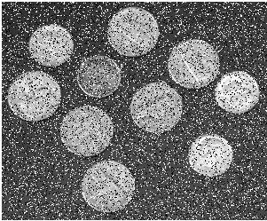

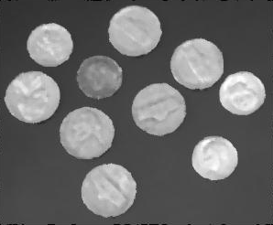
Mask Processing Techniques (cont.…)
Example of Median Filtering
Helps in reducing salts & pepper noise
Coin with 20% salt & Pepper Noise
Using a 3×3 Median Filter
Using a 5×5 Median Filter

Slide 77
Mask Processing Techniques (cont.…)
Sharpen Filtering
Increases the sharpness of the image
Objective is to highlight the intensity details of an image
Derivative operators generally increase the sharpness of the image
First order and second order derivative operators are used for this purpose

Slide 78
Mask Processing Techniques (cont.…)
Sharpen Filtering (cont.…)
First Order Derivative Filter | Second Order Derivative Filter
Must be zero in areas of constant gray level Non-zero at the onset of a gray-level step or ramp Non-zero along ramp | Zero in flat areas Non-zero at the onset and end of a gray level step or ramp Zero along ramp of constant slope

Slide 79
Mask Processing Techniques (cont.…)
Sharpen Filtering (cont.…)
Derivative in continuous domain
Derivative in discrete domain
In image, the smallest possible value of ‘h’ is 1, then the discrete version of derivative is
First Order Derivative
Second Order Derivative

Slide 80
Mask Processing Techniques (cont.…)
Sharpen Filtering (cont.…)
5 | 5 | 4 | 3 | 2 | 1 | 0 | 0 | 0 | 6 | 0 | 0 | 0 | 0 | 1 | 3 | 1 | 0 | 0 | 0 | 0 | 7 | 7
1D Signal
f’
f’’
[Observation of 1st order and 2nd order Derivative over a 1-D signal]

Slide 81
Mask Processing Techniques (cont.…)
Sharpen Filtering (cont.…)
Observations from the previous Example
1st order derivative generally produces thicker edges in an image
2nd order derivative gives stronger response to fine details such as thin lines and isolated points
1st order derivative has stronger response to gray level step
2nd order derivative produces a double response at step edges
We can conclude that 2nd order derivative are better suited for image enhancement
Most widely used 2nd order derivative is Laplacian Operator

Slide 82
Mask Processing Techniques (cont.…)
Sharpen Filtering (cont.…)
Formulation of Laplacian operator
Laplacian of a function in continuous domain
Laplacian in discrete domain

Slide 83
Mask Processing Techniques (cont.…)
Sharpen Filtering (cont.…)
Formulation of Laplacian operator (cont.…)
Laplacian of a function in discrete domain
Laplacian masks
0 | 1 | 0
1 | -4 | 1
0 | 1 | 0
0 | -1 | 0
-1 | 4 | -1
0 | -1 | 0
1 | 1 | 1
1 | -8 | 1
1 | 1 | 1
-1 | -1 | -1
-1 | 8 | -1
-1 | -1 | -1
For Horizontal & vertical Lines
For Horizontal & vertical and diagonal Lines

Slide 84
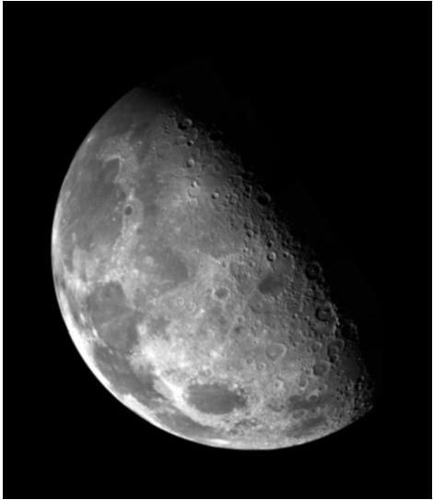

Mask Processing Techniques (cont.…)
Sharpen Filtering (cont.…)
Example using Laplacian Operator
Blurry
Moon
image
Enhanced
image
using
Laplacian

Slide 85
Filters
We will mainly focus on two types of filters:
Smoothing (low-pass)
Sharpening (high-pass)

Slide 86
Smoothing Filters (low-pass)
Useful for reducing noise and eliminating small details.
The elements of the mask must be positive.
Sum of mask elements is 1 (after normalization).
Gaussian

Slide 87


Smoothing filters – Example
Useful for reducing noise and eliminating small details.
input image
smoothed image

Slide 88
Sharpening Filters (high-pass)
Useful for highlighting fine details.
The elements of the mask contain both positive and negative weights.
Sum of mask elements is 0.
1st derivative
of Gaussian
2nd derivative
of Gaussian

Slide 89
Sharpening Filters (cont’d)
Useful for highlighting fine details.
e.g., emphasize edges

Slide 90

Sharpening Filters - Example
Note that the response of sharpening might be negative.
Values must be re-mapped to [0, 255]
input image
sharpened image

Slide 91
Smoothing Filters
Averaging
Gaussian
Median filtering (non-linear)

Slide 92

Smoothing Filters: Averaging

Slide 93

Smoothing Filters: Averaging (cont’d)
Mask size determines the degree of smoothing (loss of detail).
original
3x3
5x5
7x7
15x15
25x25

Slide 94

Smoothing Filters: Averaging (cont’d)
Example: extract largest, brightest objects
15 x 15 averaging
image thresholding

Slide 95

Smoothing filters: Gaussian
The weights are Gaussian samples:
σ = 1.4
mask size is
a function of σ:

Slide 96
Smoothing filters: Gaussian (cont’d)
σ controls the amount of smoothing
As σ increases, more samples must be obtained to represent
the Gaussian function accurately.
σ = 3

Slide 97
Smoothing filters: Gaussian (cont’d)

Slide 98



Averaging vs Gaussian Smoothing
Averaging
Gaussian

Slide 99

Smoothing Filters: Median Filtering (non-linear)
Very effective for removing “salt and pepper” noise (i.e., random occurrences of black and white pixels).
median
filtering
averaging

Slide 100

Smoothing Filters: Median Filtering (cont’d)
Replace each pixel by the median in a neighborhood around the pixel.

Slide 101
Sharpening Filters
Unsharp masking
High Boost filter
Gradient (1st derivative)
Laplacian (2nd derivative)

Slide 102



Sharpening Filters: Unsharp Masking
Obtain a sharp image by subtracting a lowpass filtered (i.e., smoothed) image from the original image:
-
=
(after contrast
enhancement)

Slide 103


Sharpening Filters: High Boost
Image sharpening emphasizes edges but low frequency components are lost.
High boost filter: amplify input image, then subtract a lowpass image.
(A-1)
+
=

Slide 104
Sharpening Filters: High Boost (cont’d)
If A=1, we get unsharp masking.
If A>1, part of the original image is added back to the high pass filtered image.
One way to implement high boost filtering is using the masks below:

Slide 105

Sharpening Filters: High Boost (cont’d)
A=1.4
A=1.9

Slide 106

Sharpening Filters: Derivatives
Taking the derivative of an image results in sharpening the image.
The derivative of an image (i.e., 2D signal) can be computed using the gradient.

Slide 107
Gradient
The gradient is a vector which has magnitude and direction:
(approximation)
or

Slide 108

Gradient (cont’d)
Gradient magnitude: provides information about edge strength.
Gradient direction: perpendicular to the direction of the edge.

Slide 109

Gradient Computation
Approximate gradient using finite differences:
Δx

Slide 110
Gradient Computation (cont’d)
sensitive to horizontal edges
sensitive to vertical edges

Slide 111



Example: visualize partial derivatives

Slide 112
Implement Gradient Using Masks
We can implement and using masks:
(x+1/2,y)
good approximation
at (x+1/2,y)
(x,y+1/2)
*
*
good approximation
at (x,y+1/2)
Example: approximate gradient at z₅

Slide 113
Implement Gradient Using Masks (cont’d)
A different approximation of the gradient:
good approximation
(x+1/2,y+1/2)
*
We can implement and using the following masks:

Slide 114
Implement Gradient Using Masks (cont’d)
Other approximations
Prewitt
Sobel

Slide 115

Example: Gradient Magnitude Image
Gradient Magnitude
(isotropic)

Slide 116

Laplacian
The Laplacian (2nd derivative) is defined as:
(dot product)
Approximate
2nd derivatives:

Slide 117

Laplacian (cont’d)
Laplacian Mask
Edges can be found
by detect the zero-crossings

Slide 118
Thanks for your kind attention !!!

